Slide 1
HBase and Hive

Slide 2

HBase: Overview
An open-source version of Google BigTable
HBase is a distributed column-oriented data store built on top of HDFS
HBase is an Apache open source project whose goal is to provide storage for Hadoop Distributed Computing
Data is logically organized into tables, rows and columns

Slide 3
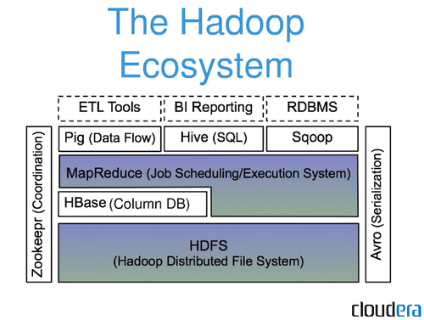
HBase: Part of Hadoop’s Ecosystem
HBase is built on top of HDFS
HBase files are internally stored in HDFS

Slide 4
HBase vs. HDFS
Both are distributed systems that scale to hundreds or thousands of nodes
HDFS is good for batch processing (scans over big files)
Not good for record lookup
Not good for incremental addition of small batches
Not good for updates

Slide 5
HBase vs. HDFS (Cont’d)
HBase is designed to efficiently address the above points
Fast record lookup
Support for record-level insertion
Support for updates (not in place)
HBase updates are done by creating new versions of values

Slide 6
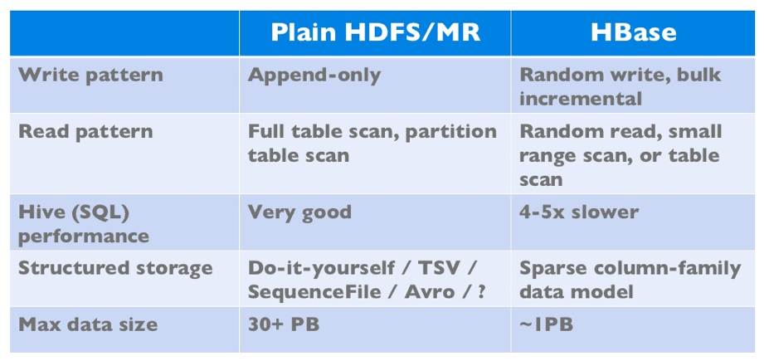
HBase vs. HDFS (Cont’d)
If application has neither random reads or writes ➔ Stick to HDFS

Slide 7
HBase Data Model

Slide 8
HBase Data Model
HBase is based on Google’s Bigtable model
Key-Value pairs

Slide 9
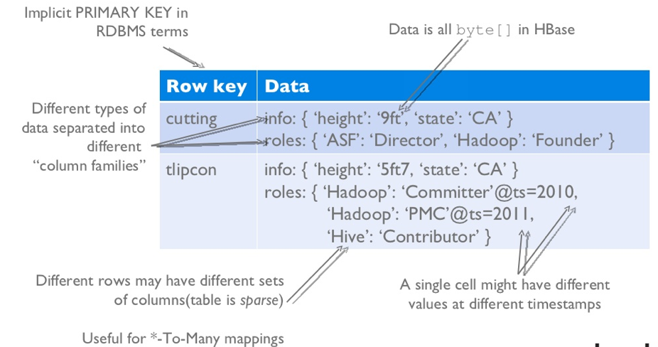
HBase Logical View

Slide 10
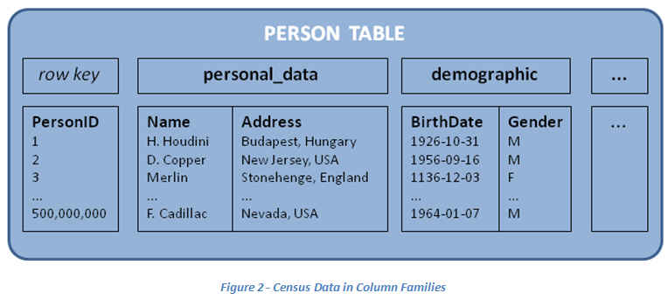
HBase: Keys and Column Families
Each record is divided into Column Families
Each row has a Key
Each column family consists of one or more Columns

Slide 11
Column family named “anchor”
Column family named “Contents”
Key
Byte array
Serves as the primary key for the table
Indexed far fast lookup
Column Family
Has a name (string)
Contains one or more related columns
Column
Belongs to one column family
Included inside the row
familyName:columnName
Column named “apache.com”

Slide 12
Version number for each row
Version Number
Unique within each key
By default→ System’s timestamp
Data type is Long
Value (Cell)
Byte array
value

Slide 13
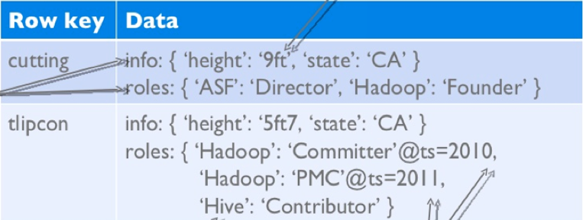
Notes on Data Model
HBase schema consists of several Tables
Each table consists of a set of Column Families
Columns are not part of the schema
HBase has Dynamic Columns
Because column names are encoded inside the cells
Different cells can have different columns
“Roles” column family has different columns in different cells

Slide 14
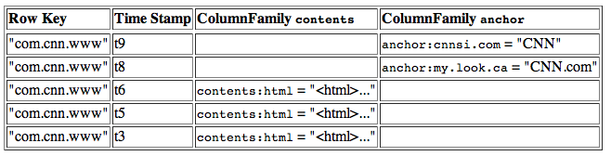
Notes on Data Model (Cont’d)
The version number can be user-supplied
Even does not have to be inserted in increasing order
Version number are unique within each key
Table can be very sparse
Many cells are empty
Keys are indexed as the primary key
Has two columns
[cnnsi.com & my.look.ca]

Slide 15
HBase Physical Model

Slide 16
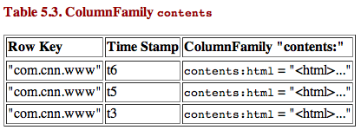
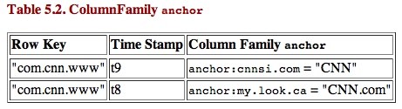
HBase Physical Model
Each column family is stored in a separate file (called HTables)
Key & Version numbers are replicated with each column family
Empty cells are not stored
HBase maintains a multi-level index on values:
<key, column family, column name, timestamp>

Slide 17
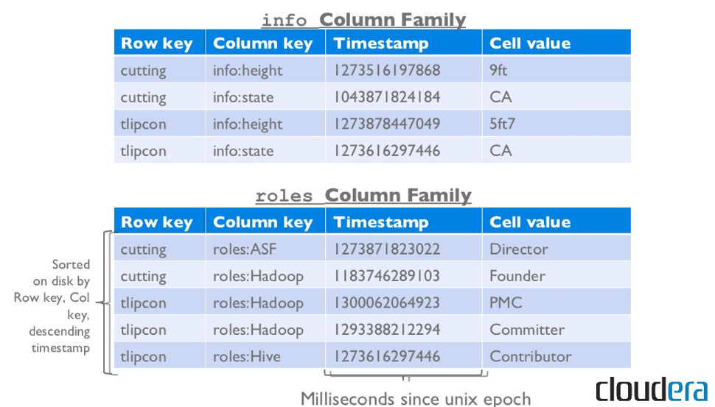
Example

Slide 18
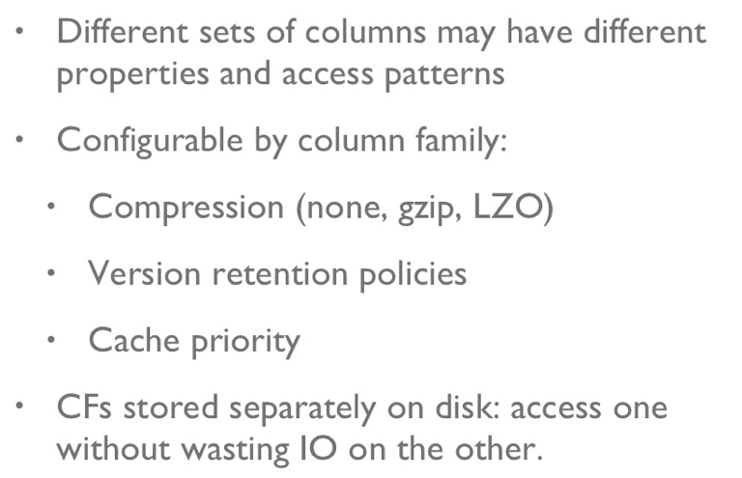
Column Families

Slide 19
HBase Regions
Each HTable (column family) is partitioned horizontally into regions
Regions are counterpart to HDFS blocks
Each will be one region

Slide 20
HBase Architecture

Slide 21
Three Major Components
The HBaseMaster
One master
The HRegionServer
Many region servers
The HBase client

Slide 22
HBase Components
Region
A subset of a table’s rows, like horizontal range partitioning
Automatically done
RegionServer (many slaves)
Manages data regions
Serves data for reads and writes (using a log)
Master
Responsible for coordinating the slaves
Assigns regions, detects failures
Admin functions

Slide 23
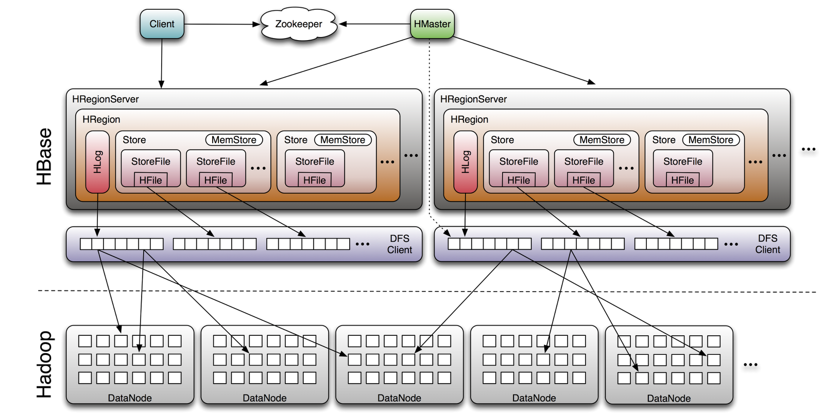
Big Picture

Slide 24
Demo: HBase on Azure
Create an HBase cluster
Log into the cluster using ssh
Start Hbase shell:
hbase shell
list existing tables
list
get all rows
scan ‘Contacts’
get one row
get 'Contacts', '1000‘
update one row
put 'Contacts', '1000', 'Personal:Name', ‘New Name‘
get 'Contacts', '1000'

Slide 25
HBase vs. HDFS

Slide 26
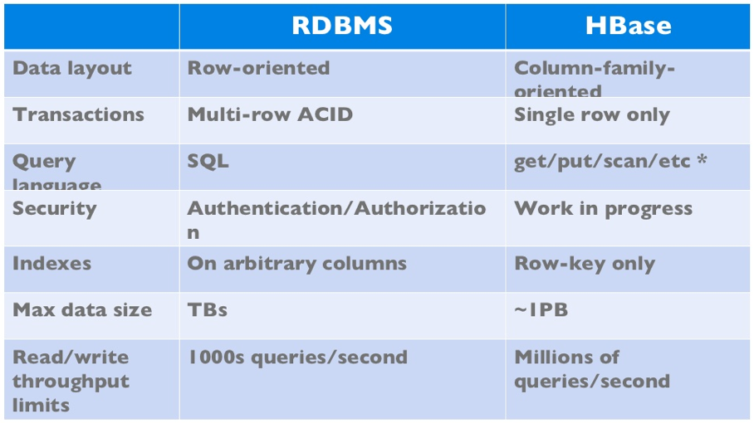
HBase vs. RDBMS

Slide 27
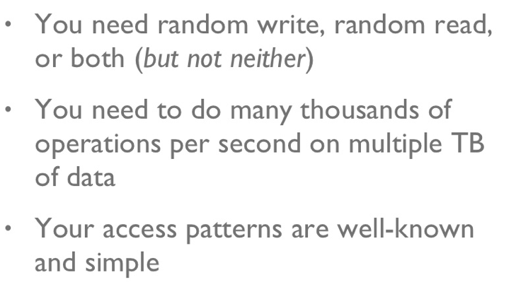
When to use HBase

Slide 28
HBase: Joins
HBase does not support joins
Can be done in the application layer
Using scan() and get() operations
Hive and Spark

Slide 29

Hive

Slide 30
Hive
Hive: data warehousing application in Hadoop
Query language is HQL, variant of SQL
Tables stored on HDFS as flat files
Developed by Facebook, now open source
Common idea:
Provide higher-level language to facilitate large-data processing
Higher-level language “compiles down” to MapReduce jobs

Slide 31
Data Model
Tables
Typed columns (int, float, string, boolean)
Also, list: map (for JSON-like data)
Partitions
For example, range-partition tables by date
Buckets
Hash partitions within ranges (useful for sampling, join optimization)
Source: cc-licensed slide by Cloudera

Slide 32
Metastore
Database: namespace containing a set of tables
Holds table definitions (column types, physical layout)
Holds partitioning information
Can be stored in Derby, MySQL, and many other relational databases
Source: cc-licensed slide by Cloudera

Slide 33
Physical Layout
Warehouse directory in HDFS
E.g., /user/hive/warehouse
Tables stored in subdirectories of warehouse
Partitions form subdirectories of tables
Actual data stored in flat files
Control char-delimited text, or SequenceFiles
With custom SerDe, can use arbitrary format
Source: cc-licensed slide by Cloudera

Slide 34
Hive: Example
Hive looks similar to an SQL database
Support Joins
Source: Material drawn from Cloudera training VM

Slide 35
Hive: Behind the Scenes
SELECT s.word, s.freq, k.freq FROM shakespeare s
JOIN bible k ON (s.word = k.word) WHERE s.freq >= 1 AND k.freq >= 1 ORDER BY s.freq DESC LIMIT 10;
(Abstract Syntax Tree)
(TOK_QUERY (TOK_FROM (TOK_JOIN (TOK_TABREF shakespeare s) (TOK_TABREF bible k) (= (. (TOK_TABLE_OR_COL s) word) (. (TOK_TABLE_OR_COL k) word)))) (TOK_INSERT (TOK_DESTINATION (TOK_DIR TOK_TMP_FILE)) (TOK_SELECT (TOK_SELEXPR (. (TOK_TABLE_OR_COL s) word)) (TOK_SELEXPR (. (TOK_TABLE_OR_COL s) freq)) (TOK_SELEXPR (. (TOK_TABLE_OR_COL k) freq))) (TOK_WHERE (AND (>= (. (TOK_TABLE_OR_COL s) freq) 1) (>= (. (TOK_TABLE_OR_COL k) freq) 1))) (TOK_ORDERBY (TOK_TABSORTCOLNAMEDESC (. (TOK_TABLE_OR_COL s) freq))) (TOK_LIMIT 10)))
(one or more of MapReduce jobs)

Slide 36
MapReduce Code
Pig Slides adapted from Olston et al.

Slide 37
Hive + HBase

Slide 38

Integration
How it works:
Hive can use tables that already exist in HBase or manage its own ones, but they still all reside in the same HBase instance
Hive table definitions
HBase
Points to an existing table
Manages this table from Hive

Slide 39
Integration
How it works:
When using an already existing table, defined as EXTERNAL, you can create multiple Hive tables that point to it
Hive table definitions
HBase
Points to some column
Points to other columns, different names

Slide 40
Integration
How it works:
Columns are mapped however you want, changing names and giving types
Hive table definition
HBase table
persons
people
name STRING
d:fullname
age INT
d:age
siblings MAP<string, string>
d:address
f:
Notes:
a column name was changed, one isn’t used, and a map points to a family

Slide 41
Demo on Azure
Open the Hive shell
hive
Create a Hive external table that maps to the HBase table
CREATE EXTERNAL TABLE hbasecontacts(rowkey STRING, name STRING, homephone STRING, officephone STRING, officeaddress STRING)
STORED BY 'org.apache.hadoop.hive.hbase.HBaseStorageHandler'
WITH SERDEPROPERTIES ('hbase.columns.mapping' = ':key,Personal:Name,Personal:Phone,Office:Phone,Office:Address')
TBLPROPERTIES ('hbase.table.name' = 'Contacts');
Run the HiveQL queries on the Hbase table: hbasecontacts

Slide 42
Accessing HBase from Spark
https://github.com/hortonworks-spark/shc

